Slide 1
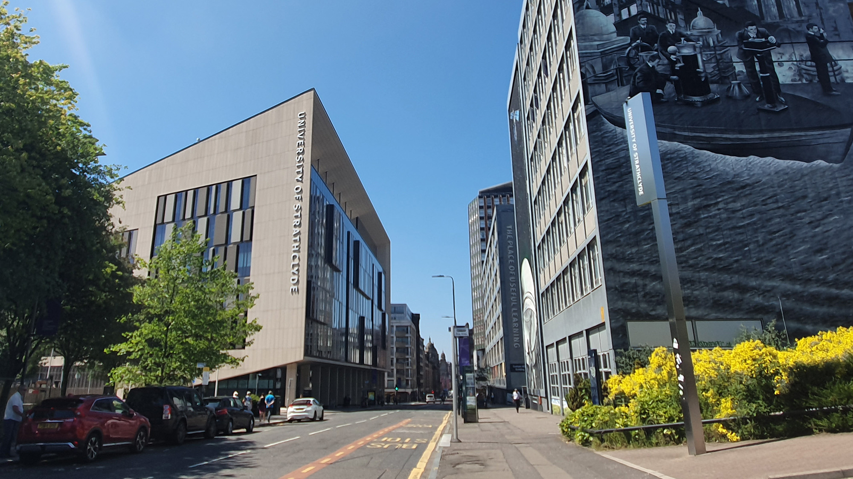

Tutorial 6
EE469/EE669/EE869/EE969
Module Introduction
carmine.clemente@strath.ac.uk

Slide 2
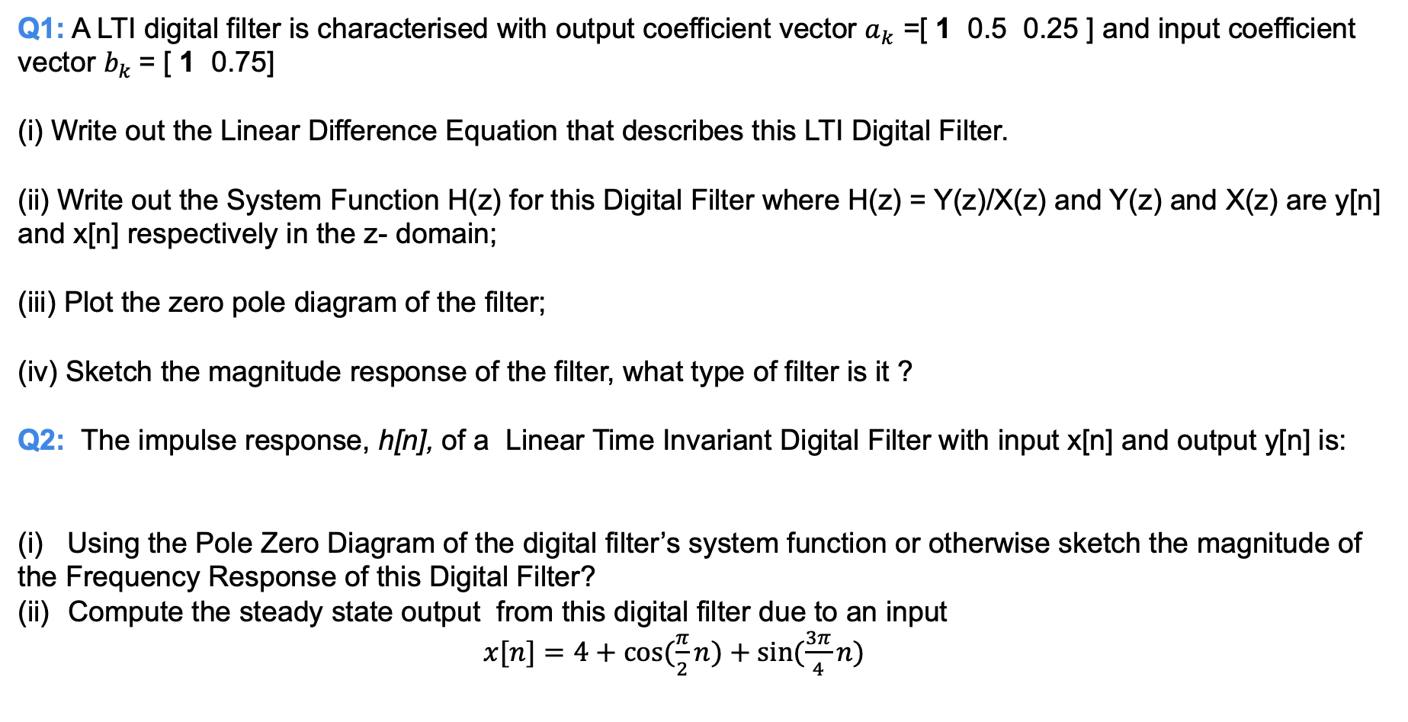
Question
Q1: A LTI digital filter is characterised with output coefficient vector $a_{k}$ =[ 1 0.5 0.25 ] and input coefficient vector $b_{k}$= [ 1 0.75]
(i) Write out the Linear Difference Equation that describes this LTI Digital Filter.
(ii) Write out the System Function H(z) for this Digital Filter where H(z) = Y(z)/X(z) and Y(z) and X(z) are y[n] and x[n] respectively in the z- domain;
(iii) Plot the zero pole diagram of the filter;
(iv) Sketch the magnitude response of the filter, what type of filter is it ?
Q2: The impulse response, h[n], of a Linear Time Invariant Digital Filter with input x[n] and output y[n] is:
(i) Using the Pole Zero Diagram of the digital filter’s system function or otherwise sketch the magnitude of the Frequency Response of this Digital Filter?
Compute the steady state output from this digital filter due to an input
$x[n]=4+cos⁡(\frac{π}{2}n)+sin⁡(\frac{3π}{4}n)$

Slide 3
X THE PLACE OF USEFUL LEARNING

